Slide 1

GOD HIERARCHIES
Development of a Comprehensive Multi-Mythology Deity Knowledge Base
in Prolog for Comparative Religious Studies
Presented by: Afrin Sultana Akhi

Slide 2
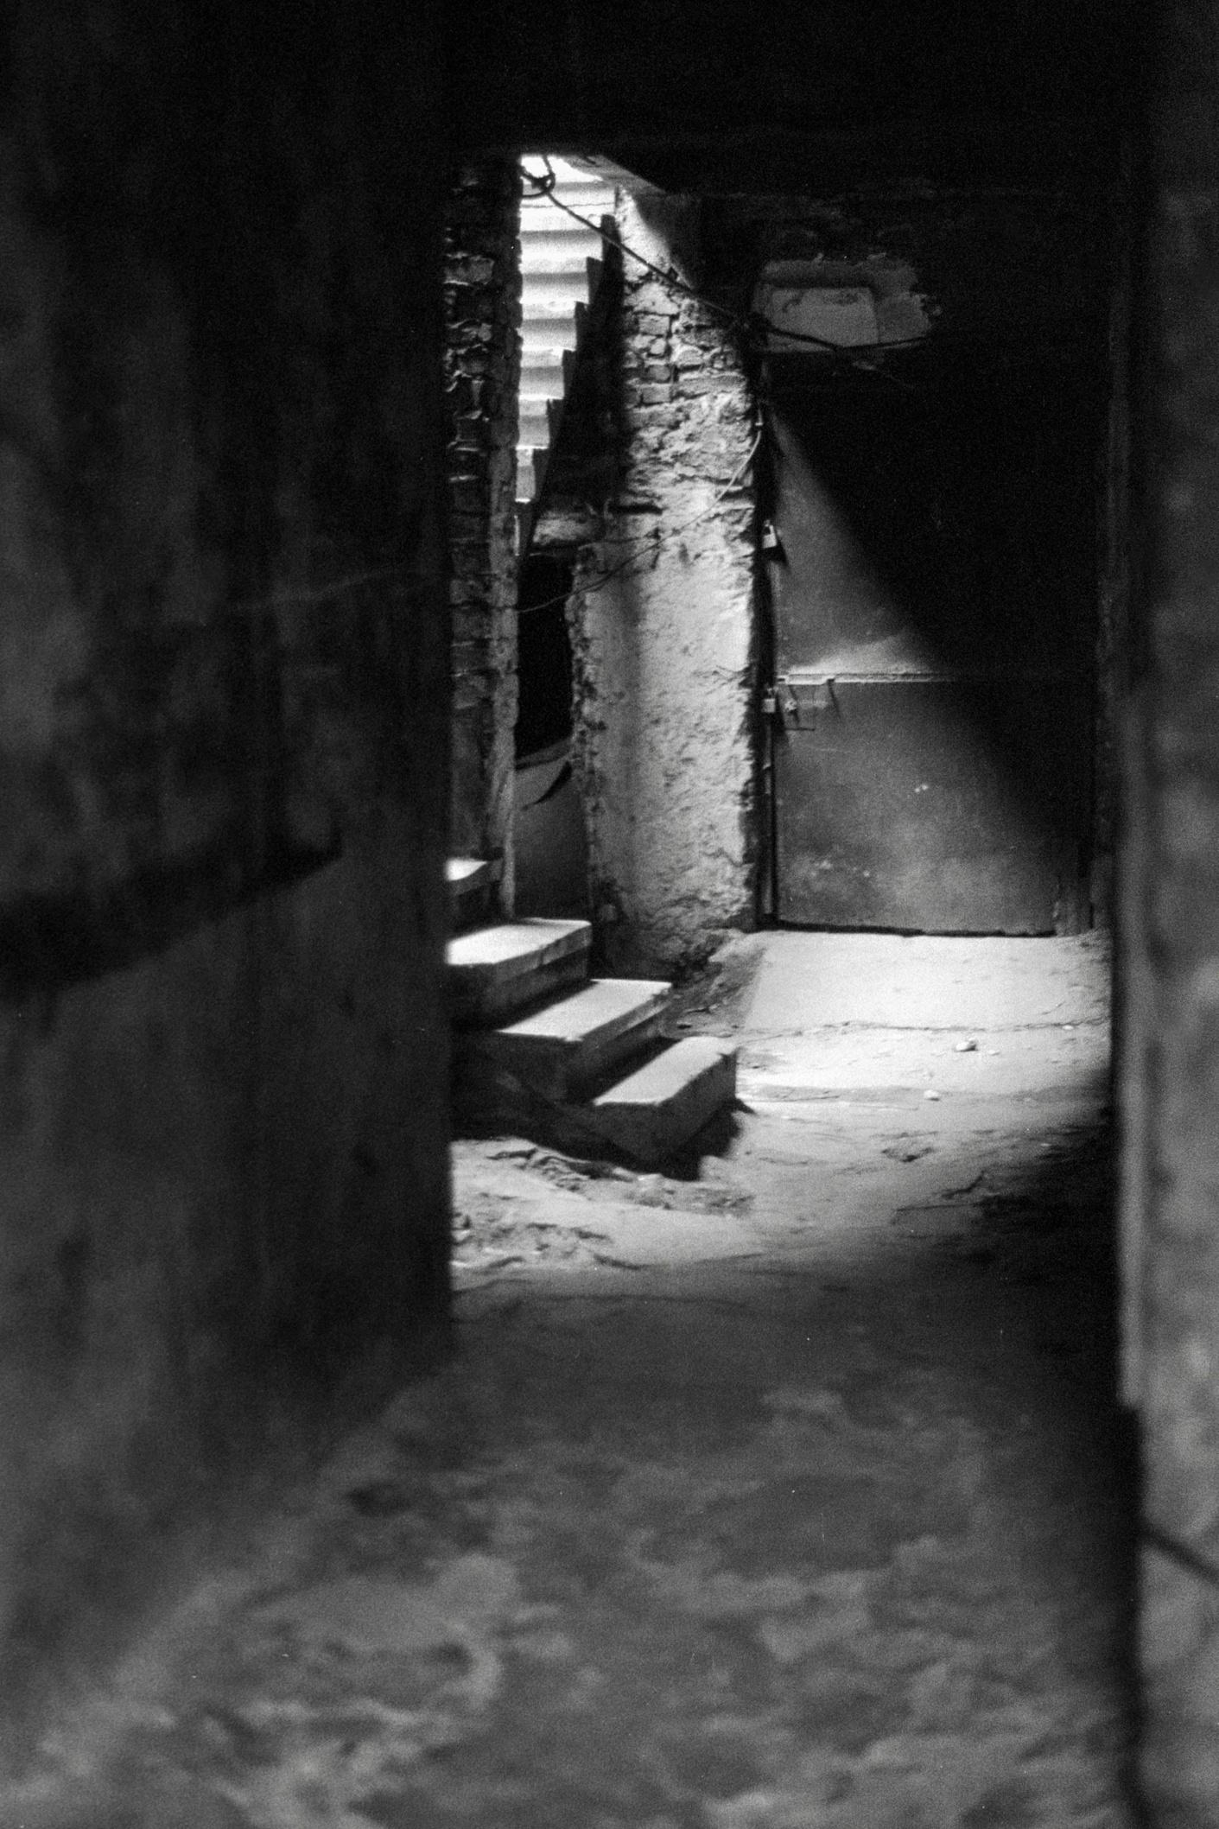
PROBLEM
STATEMENT
– There is a lack of efficient, centralized resources to explore religious, mythological, stories in one place.
The project addresses the need for a structured, queryable knowledge base that organizes information about deities from multiple world religions and mythologies. Traditional approaches to studying comparative mythology often lack systematic.organization and computational querying capabilities.
• Lack of unified structure for cross-mythology comparisons
• Difficulty in tracking complex family relationships across different pantheons
• Need for systematic classification of divine domains and powers
• Requirement for flexible querying of mythological data
• Educational tool for understanding religious hierarchies and relationships

Slide 3
BACKGROUND
Mythological
Folklore
Religious
Mythological stories are ancient tales about gods, heroes, and supernatural events.
Folklore stories are passed down in communities and often involve spirits, monsters. These tales reflect local traditions and teach morals.
Religious stories focus on gods, angels, and miracles. They guide people’s beliefs and show the connection between humans and the divine.

Slide 4


OBJECTIVE
The knowledge base encompasses 10 major mythological traditions:
- Ancient mythologies: Greek, Norse, Hindu, Japanese, Egyptian, Celtic
- Abrahamic religions: Islamic, Christian, Jewish traditions
- Total coverage: 72 deities and religious figures with complete relationship mappings

Slide 5
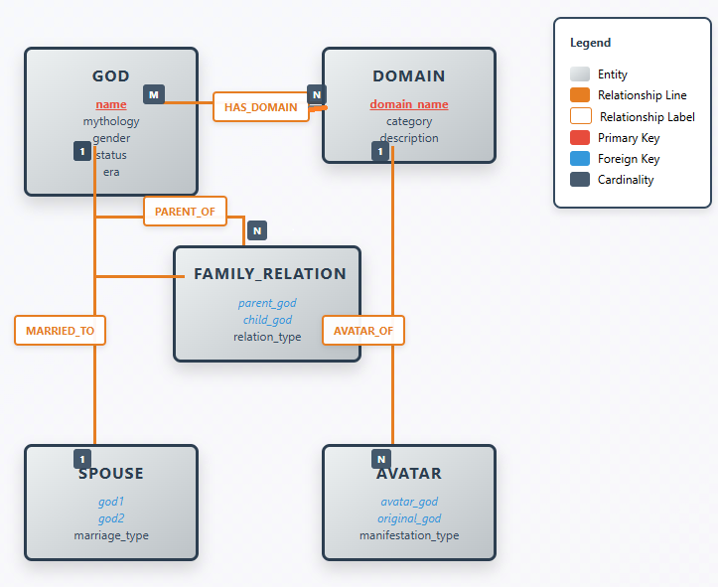
DIAGRAM
shows the relationships and classifications of supernatural beings in the knowledge base.

Slide 6



TOOLS USED
SWI-Prolog
Visual Studio Code
Canva
Prolog programming environment
Code Editor
Design and presentation

Slide 7
KEY FEATURES
Categorization by Origin & Hierarchical classification
The knowledge base classifies beings based on their cultural origin (e.g., Greek, Norse, Islamic, Hindu).
Domain and Role Associations
The system stores what domains the beings are associated with, such as thunder, war, or wisdom.
Type Identification
Each entity is identified as a god, spirit, demon, etc.
Relationship Mapping
Logical relationships like "father of," "servant of," or "enemy of" are modeled to show mythological connections.
Interactive Queries
Users can ask meaningful questions like
[ ?- supernatural(jinn).]

Slide 8
TECHNICAL
REPORT
Report Link
Github: Technical Report
This technical report explains how the project was built using Prolog to organize information about supernatural beings from religious, folklore, and mythological sources. It includes the tools used like SWI-Prolog and draw.io, how the data was structured, and how relationships were shown through logic rules. The report also highlights some challenges faced during the design, shows sample queries, and explains how the knowledge base was made to give clear and useful answers.

Slide 9
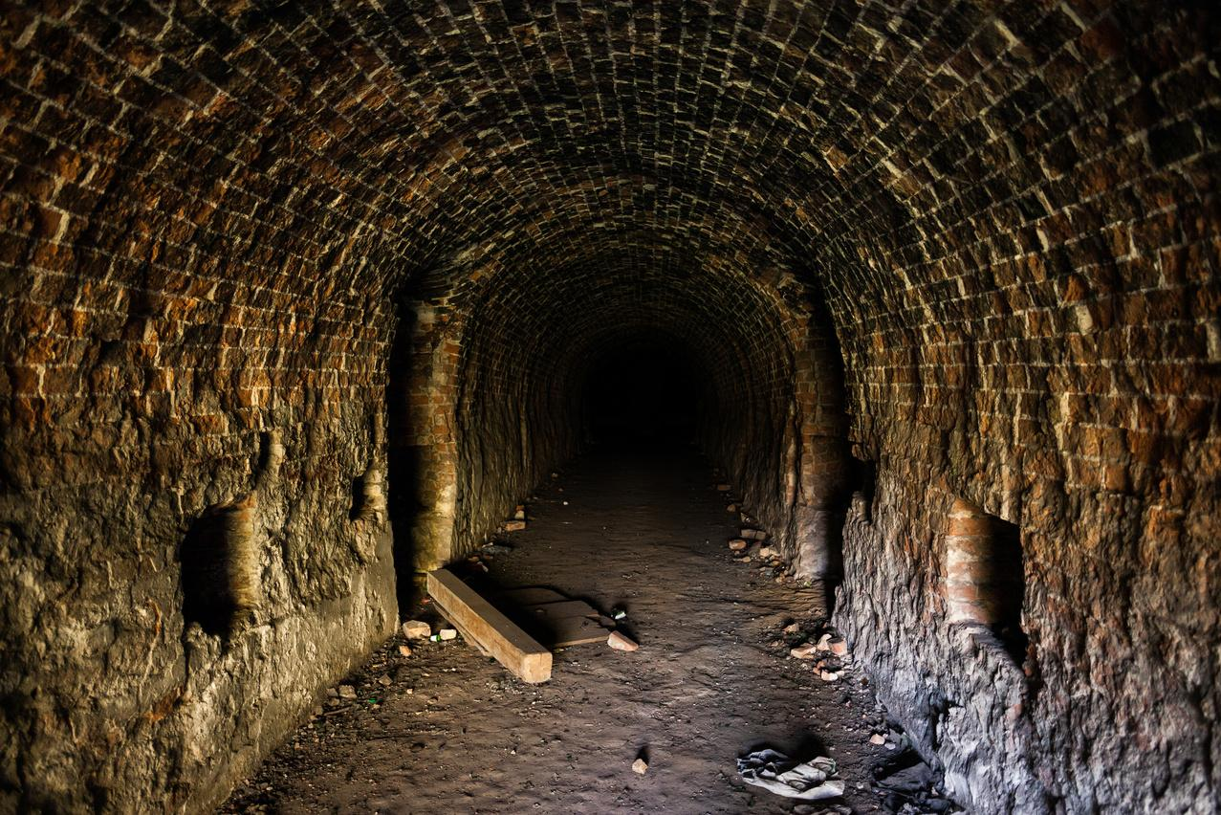
SOURCE CODE
The project’s source code consists of a structured Prolog knowledge base, including numerous facts and logical rules representing supernatural beings from religious, folklore, and mythological origins. With over 450+ lines of well-documented code, displaying everything here would be impractical. Instead, the entire codebase has been organized and uploaded to GitHub for easier viewing, sharing, and future collaboration.
🔗 GitHub Repository: Code

Slide 10
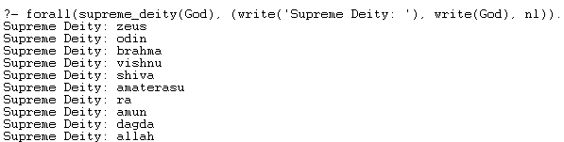
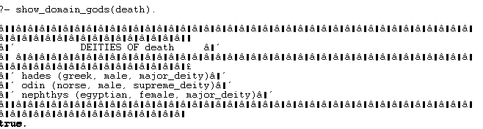
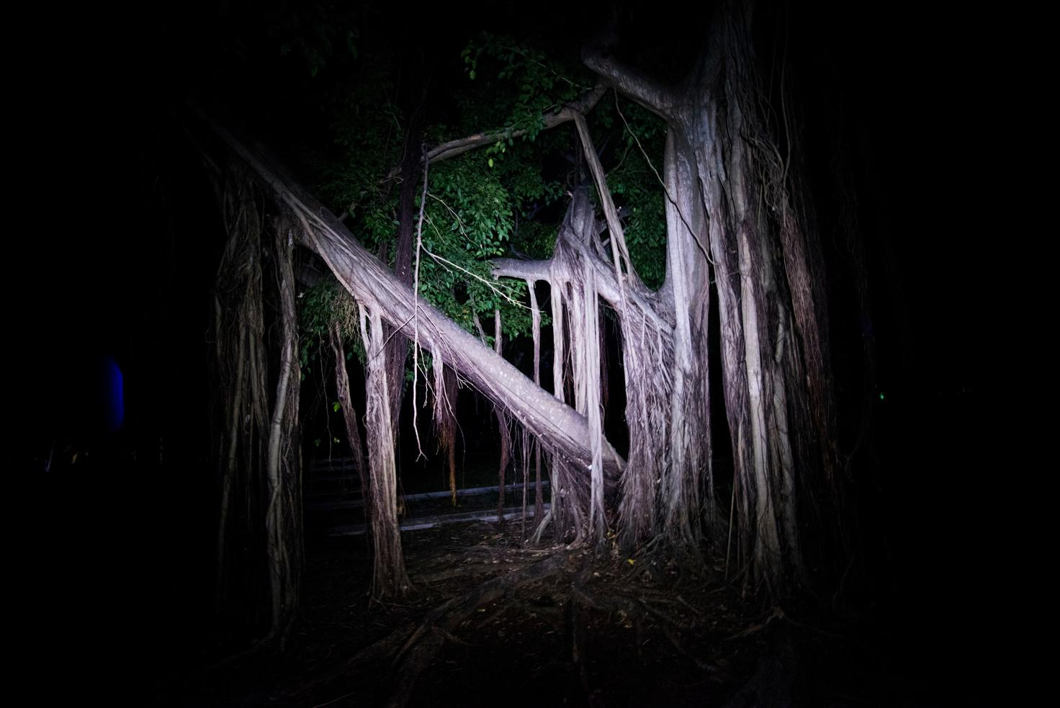

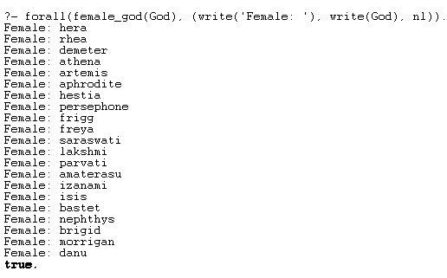
SAMPLE OUTPUT
Below are some example queries and their outputs, showcasing how the system responds to user input by retrieving relevant supernatural beings from the knowledge base.

Slide 11

This project solves the issue of not having a central place to explore supernatural beings from religious, folklore, and mythological stories. Built using Prolog, it creates a logical structure where users can search and discover meaningful connections. Though it's simple, it lays the groundwork for future development.
Key Takeaways:
Organized diverse supernatural knowledge into one query-based system
Built meaningful relationships using facts and rules in Prolog
Simple UI through logical queries for easy interaction
Can be improved further with more content, visuals, or a web interface
This project not only addresses the need for an organized supernatural knowledgebase but also highlights the power of logic programming in cultural studies. I hope it inspires further exploration and appreciation of the rich tapestry of mythology, religion, and folklore from around the world.
CON
CLU
SION

Slide 12

THANK YOU !
Thank You for Hearing
“GOD HIERARCHIES”
Your time and interest are truly appreciated.
Feel free to ask any questions or share your thoughts!

